Slide 1
Maintenance Knowledge Advisor
RAG based model

Slide 2
Available models for llm
OpenAi’s embedding-ada-002
Need OpenAi’s API key
Performance->Best Overall
Mistral Ai’s mixtral-8x-7B
Open source
Performance->Best for QnA
Meta’s llama3-8B
Open source
Performance->Okay suited for all
Google’s gemma-7B
Open source
Performance->Does not satisfy purpose
https://towardsdatascience.com/openai-vs-open-source-multilingual-embedding-models-e5ccb7c90f05
https://www.ankursnewsletter.com/p/comparative-analysis-gemma-7b-vs

Slide 3
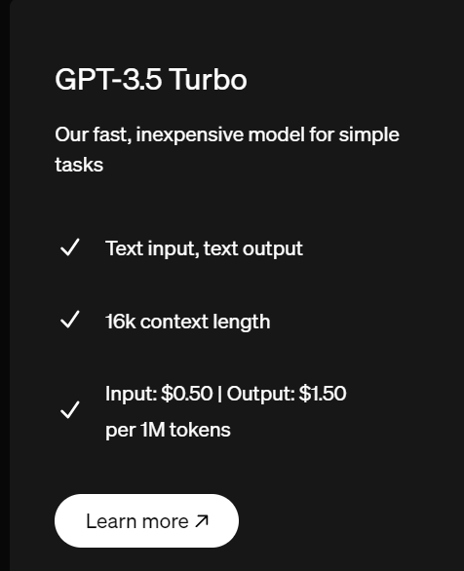
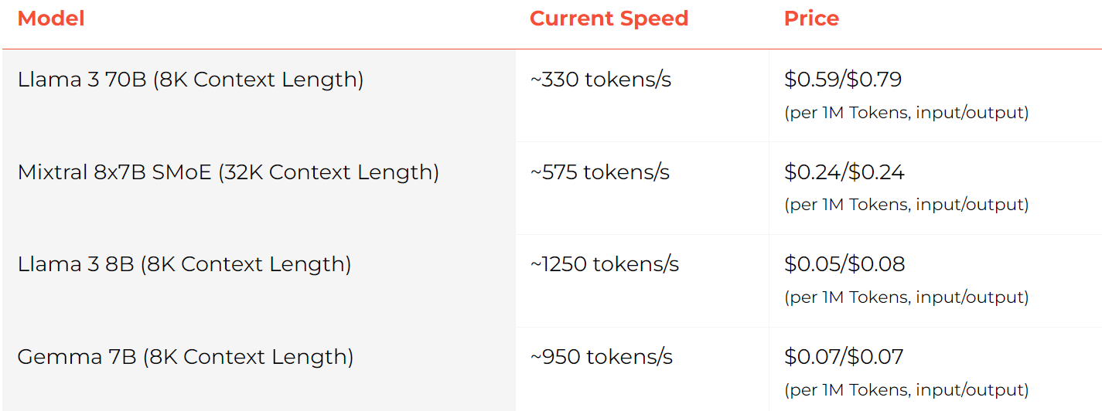
Need of GPUs
OpenAi API
Link: https://openai.com/api/
Groq API
Link: https://wow.groq.com/
! !Data privacy compromised! !

Slide 4
Vector DataBase
FAISS
Open source software
Uses GPU to efficiently manage extensive datasets
ChromaDB
Open source
Leverges in-memory storage mechanisms to datasets without latency issues
Pinecone
Paid
Similar to ChromaDB

Slide 5
Search Application
Streamlit
More Customizable
Chainlit
Supports OpenAi applications

